Slide 1
JOURNAL CLUB PRESENTATION
PRESENTERS:
DR. MUHUDI YASINI
DR. ALLAN MUNISI
DR. VIOLET WILBARD
DATE: 17TH JULY 2026

Slide 2
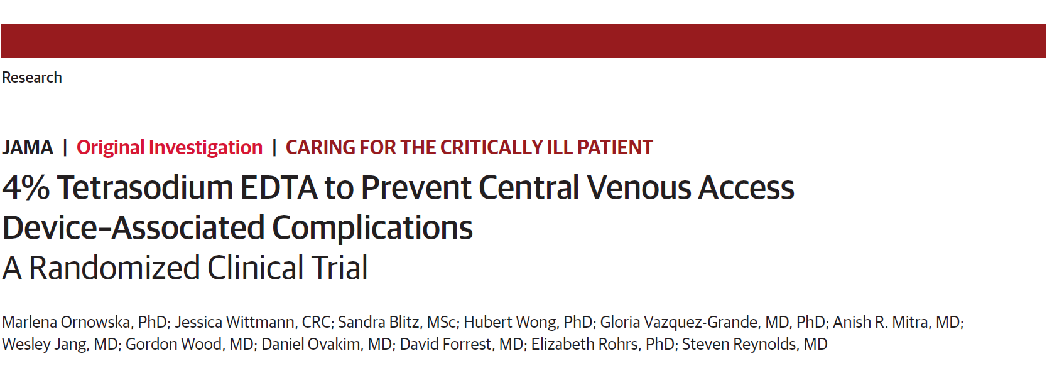
May 2026

Slide 3
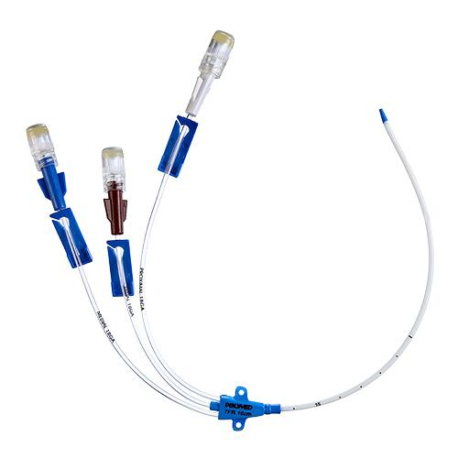
BACKGROUND
CVAD is an indwelling device inserted into a large, central vein (most commonly the internal jugular, subclavian or femoral)
The catheter tip is positioned in the superior vena cava (SVC), inferior vena cava (IVC), or right atrium for reliable central venous access
WHO 2026 Guidelines for prevention of BSI and other infections associated with use of intravascular catheter

Slide 4
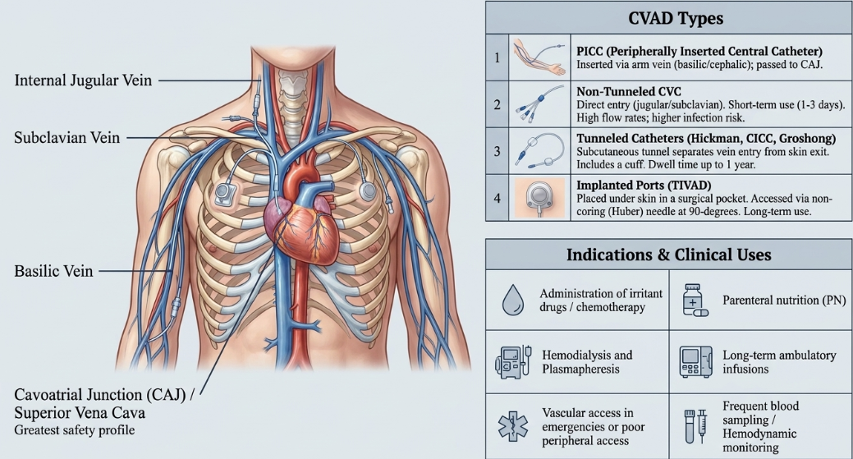
BACKGROUND

Slide 5
COMPLICATIONS OF CVAD
Clinically important complications
  CLABSI/CRBSI
  Catheter occlusion
  Catheter colonization
  Catheter-associated venous thrombosis
Notes:
Thrombolytic use
Catheter removal due to occlusion
CAT

Slide 6
COMPLICATIONS OF CVAD
CLABSI: Laboratory-confirmed bloodstream infection in a patient with a CVAD in place for >48 hours, with no other identifiable source
CRBSI: Bloodstream infection microbiologically confirmed to originate from the catheter
Catheter colonization: Significant microbial growth on the catheter tip, indicating catheter contamination without necessarily causing bloodstream infection
1.WHO 2026 Guidelines for prevention of BSI and other infections associated with use of intravascular catheter
2.Mermel, L. A., Allon, et al. (2009). Clinical Practice Guidelines for the Diagnosis and Management of Intravascular Catheter-Related Infection: 2009 Update by the Infectious Diseases Society of America. Clinical Infectious Diseases, 49(1), 1–45
Notes:
is defined by the Centers for Disease Control and Prevention (CDC) National Healthcare Safety Network as the isolation of a pathogen from a blood culture in a patient who had an intravenous (IV) central line on the event day or one day before
It requires
Concordant Catheter Tip culture
Differential Time to Positivity
Quantitative blood culture ratio
CVAD Colonization defined as growth of <15 CFU from 5cm segment of removed catheter tip by semi quantitative culture or growth of >10^2 from catheter tip by quantitative techniques

Slide 7
EPIDEMIOLOGY
A 2018 meta-analysis on Complication and Failures of CVADs in Adult Critical Care Settings reported
  CLABSI: 4.59 per 1000 catheter-days
  Catheter-associated venous thrombosis: 8.34 per 1000 catheter-days
  Catheter occlusion affects between 4% and 22% of all CVADs in adult ICUs
Takashima, M., Schults, J., Mihala, G., Corley, A., & Ullman, A. (2018). Complication and Failures of Central Vascular Access Device in Adult Critical Care Settings*. Critical Care Medicine, 46(12), 1998–2009

Slide 8
EPIDEMIOLOGY
Hospital based study done in Kenya determine the rate of CLABSI among the patient admitted in ICU for duration of 1 year revealed;
  CLABSI: 13.4 per 1000 central-line days
In Tanzania, study done among patient undergoing hemodialysis at KCMC revealed;
  56.6% of studied population developed CRBSI
1.Costantine, A. R., Urasa, S. J., et al. (2025). Catheter‐Related Bloodstream Infections Among Hemodialysis Patients in Northern Tanzania: Insights From a Single‐Centre Retrospective Study. Health Science Reports, 8(1), e70338
2.Mishra, D. K., Shamanna, B. R., Busakhala, N., Singh, G., & Ojala, L. (2023). Incidence and Risk Factors of Central Line Associated Blood Stream Infections in Private Healthcare Setting in Western Kenya. 8(9)
Notes:
Hospital based Prospective study conducted at Mediheal Hospital and Ferility centre in Kenya
Sample size were 183 participants of the patients admitted ICUs
KCMC A total of 286 patients were analyzed

Slide 9
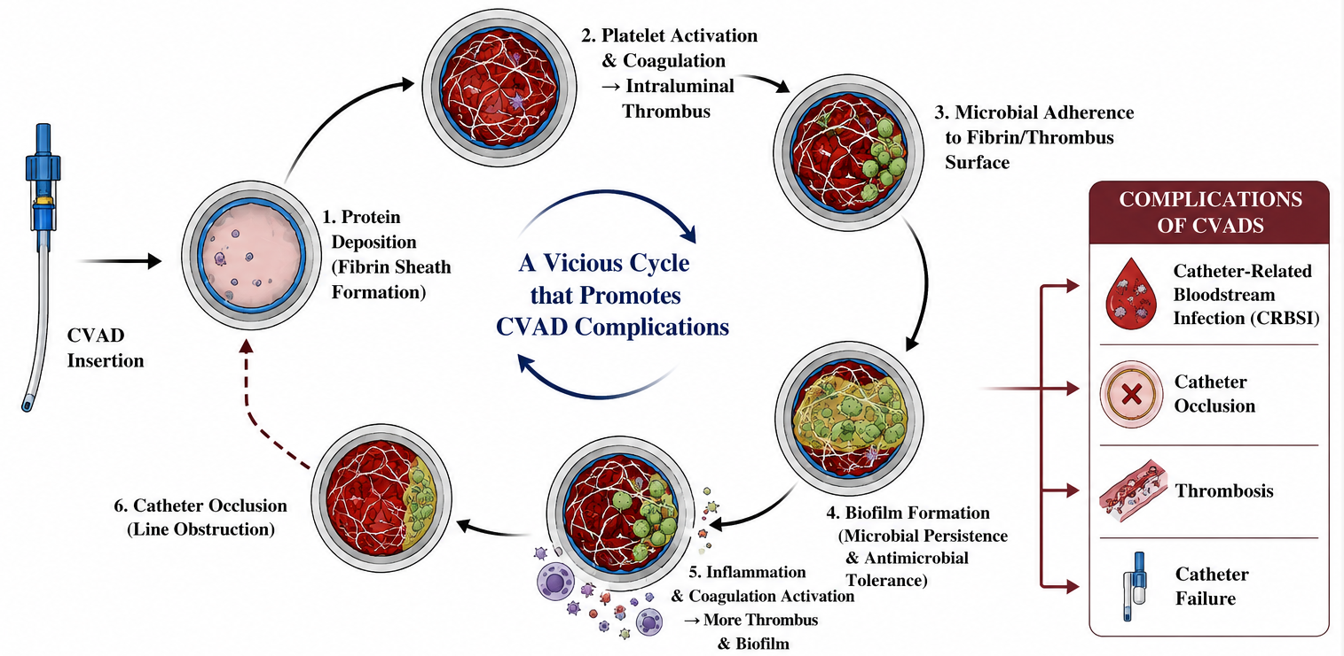
PATHOGENESIS CVAD’S COMPLICATIONS
Notes:
BAKI NA MOJA

Slide 10
PREVENTION OF CVAD COMPLICATIONS
CVAD complication prevention requires a multimodal approach throughout the catheter lifecycle—from insertion to removal
Optimal catheter maintenance is the cornerstone of preventing infection and occlusion
Key maintenance strategies:
Strict hand hygiene and aseptic technique
Standardized flushing and locking protocols

Slide 11
LOCKING PROTOCOL FOR CVAD
Locking is the process of instilling a small volume of solution into the catheter lumen after flushing while it is not in use
Lock solutions have evolved from simple anticoagulation → multifunctional prevention of catheter occlusion and infection
  Normal saline (NaCl 0.9%)
  Heparin
  Citrate (4% VS 46.7%)
  4% tetra-sodium EDTA (t-EDTA)
Ornowska, M., Smithman, J., & Reynolds, S. (2023). Locking solutions for prevention of central venous access device complications in the adult critical care population: A systematic review. PLOS ONE, 18(10), e0289938. https://doi.org/10.1371/journal.pone.0289938

Slide 12
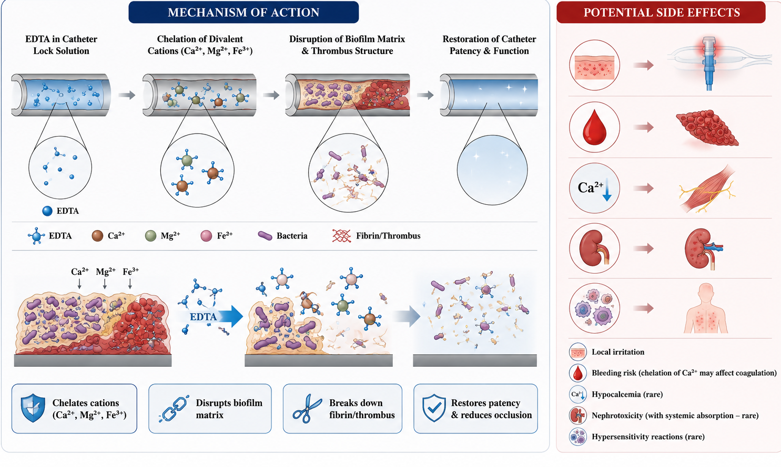
4% TETRASODIUM EDTA

Slide 13
LITERATURE REVIEW
STUDY | STUDY DESIGNS | SAMPLE SIZE | KEY FINDINGS | GAPS
Efficacy of T-EDTA catheter lock solution in home parenteral nutrition patients: A quality improvement evaluation Hill J et al 2020 | Quasi-experimental pre–post intervention quality improvement study | 105 recruited 22 eligible 20 completed | Rate of CLABSI Before EDTA: 1.918 infections/1000 catheter days After EDTA: 0.563 infections/1000 catheter days No catheter occlusion event Fewer catheter replacement | Small ample size Non randomization Single center study

Slide 14
LITERATURE REVIEW
STUDY | STUDY DESIGNS | SAMPLE SIZE | KEY FINDINGS | GAPS
Role of EDTA lock solution in preventing catheter-related bloodstream infections or central line-associated bloodstream infections Chakraborty S, et al 2025 | A systematic review and meta-analysis | 8 studies 828 total patients 403 received EDTA 425 received control lock solutions | EDTA lock solutions reduced the risk of CRBSI by 82% catheter colonization by 89% As compared with standard lock solutions | Few studies with small sample size Lack of generalizability to ICU patient

Slide 15
LITERATURE REVIEW
STUDY | STUDY DESIGNS | SAMPLE SIZE | KEY FINDINGS | GAPS
Evaluation of Tetra-sodium EDTA as a Catheter Lock Solution in Home Parenteral Nutrition Patients: Acceptability, Ease of Use, and Safety Lina Saucedo al 2025 | Prospective, open-label, single-center design | 21 Recruited and 14 completed study | No CRBSI event No serious adverse effect reported t-EDTA was feasible and acceptable | Small Sample size Short follow up period

Slide 16
PROBLEM STATEMENT
CVAD occlusion interrupts treatment and often necessitates alteplase or catheter replacement
CLABSI causes significant morbidity, mortality, and healthcare costs
Antibiotic locks may prevent infection but contribute to antimicrobial resistance
The trial investigated whether t-EDTA could safely reduce both occlusion and infection as a practical, routine ICU catheter lock solution

Slide 17
RATIONALE
Most ICU patients require a CVAD for life-saving therapies
CVAD complications are common and worsen patient outcomes
Current lock solutions do not adequately prevent both thrombosis and infection
Trial evaluated whether t-EDTA reduces lock-modifiable CVAD complications, preserves catheter patency, and improves outcomes in critically ill patients

Slide 18
RESEARCH OBJECTIVES
Primary objective
To compare the incidence of CLABSI, catheter occlusions requiring replacement and alteplase use in critical care patient with CVAD’s locked with 4% t-EDTA versus critical care patient with CVAD’s locked with standard of care solution

Slide 19
RESEARCH OBJECTIVES
Secondary Objectives
To determine
  Incidence rate of confirmed CLABSI
  Incidence rate of Catheter occlusion requiring removal
  Incidence rate of catheter obstruction requiring alteplase use
  Direct cost related to alteplase use for catheter occlusion
  Incidence rate of catheter-associated venous thrombosis
  Incidence rate of catheter colonization
  ICU length of stay and mortality

Slide 20
METHODOLOGY

Slide 21
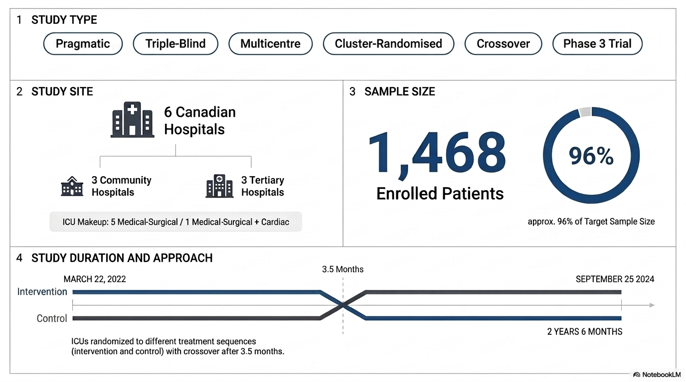
METHODOLOGY
Notes:
The planned sample size was approximately 1524 patients;
Randomization schedule was generated by a statistician and concealed from those involved in intervention delivery
Randomization occurred at the ICU/hospital level (cluster randomization) and same ICU as used as control and intervention and crossed over after 3.5 months maintaining blinding and reducing selection bias

Slide 22
METHODOLOGY: INCLUSION CRITERIA
Adults older than 18 years
Admitted to a critical care unit
Had a CVAD in place with at least one lumen not in use
Notes:
All CVAD types were eligible, including single-, double-, triple-, and quadruple-lumen central venous catheters; tunnelled and non-tunnelled catheters; dialysis lines; trialysis catheters; implanted vascular access devices; and peripherally inserted central catheters (PICCs).

Slide 23
METHODOLOGY: EXCLUSION CRITERIA
Known sensitivity or allergy to t-EDTA
Confirmed or suspected pregnancy
Refusal by the patient, treating physician, or temporary decision-maker.
Patients currently enrolled in any other research study that may confound the primary outcome measure
Notes:
One participant was excluded because they were co-enrolled in a competing study, but the competing study is not named. The participating centres were: Royal Columbian Hospital
Surrey Memorial Hospital
Nanaimo Regional General Hospital
Royal Jubilee Hospital
St. Boniface Hospital
Burnaby Hospita

Slide 24
RECRUIMENT STRATERGY
Patients were screened within the first 48 hours of ICU admission
All eligible patients in participating ICUs during each period were approached
Enrolment ran for over two years, with extra sites added to offset slow initial recruitment worsened by the COVID-19 pandemic
Notes:
All eligible patients in participating ICUs during each period were approached, with efforts made to integrate the protocol into routine ICU workflows.

Slide 25
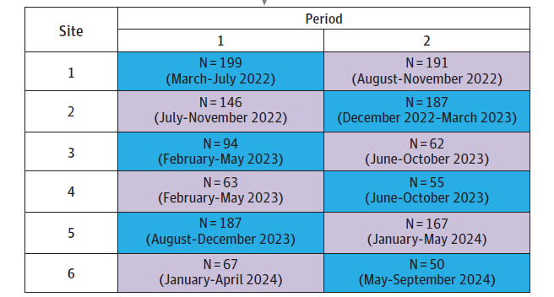
CLUSTER RANDOMIZATION
Notes:
CVAD indicates central venous access device. Blue shading represents usual care; purple shading represents 4%tetrasodium EDTA.
Each cluster period was followed by a 1-month follow-up period during which enrollment ceased in order to maximize the number of patients fulfilling 1 study condition only.

Slide 26
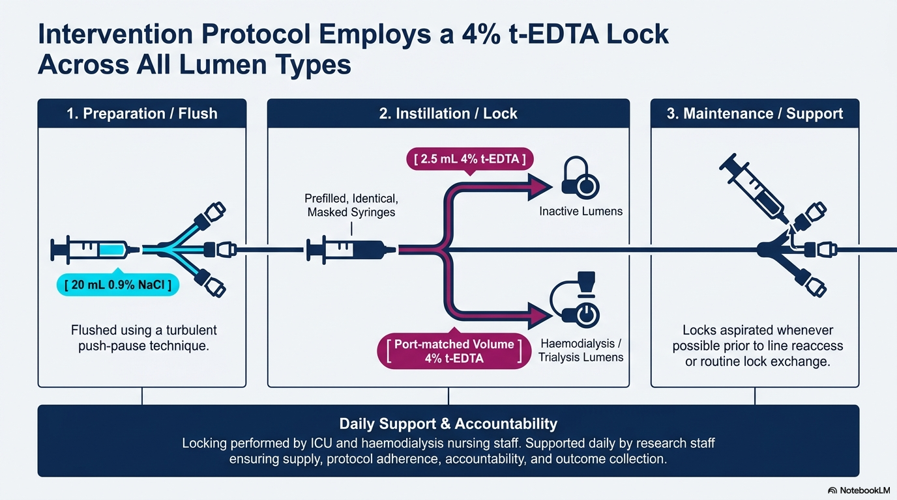
STUDY PROCEDURE
Notes:
Prefilled, identical, masked syringes containing 2.5 mL of 4% t-EDTA were then instilled into inactive lumens.
Inactive lumens (ports not actively in use) are "locked" by injecting prefilled syringes of 4% t-EDTA. For hemodialysis and trialysis lumens, the exact volume instilled is tailored to the specific port volume of the catheter to ensure the lumen is filled without pushing the solution into the patient's systemic circulation.

Slide 27
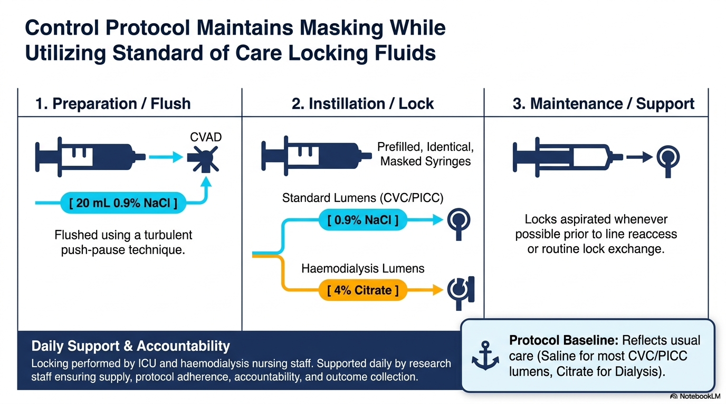
STUDY PROCEDURE
Notes:
Citrate acts as a local anticoagulant by chelating calcium and is the standard, preferred locking solution for dialysis access to prevent clotting and reduce infections

Slide 28
PRIMARY OUTCOMES
A composite of CVAD-associated bloodstream infection
Catheter occlusion needing alteplase
Catheter removal due to occlusion, measured per 1000 catheter-days

Slide 29
SECONDARY OUTCOMES
Included each component of the primary composite separately and
  Thrombosis
  Colonization
  ICU length of stay and mortality

Slide 30
FOLLOW UP
Participants were assessed throughout ICU admission until ICU discharge, death, or the end of the treatment maintenance period, whichever occurred first
There was no planned post-ICU or post-hospital follow-up for the clinical outcome assessment

Slide 31
STATISTICAL ANALYSIS
Data analysed using SAS v9.4 and R v4.4.2 (glmm TMB package)
Designed to provide 80% power at α = 0.05
Sample size based on simulation to detect a 30% relative reduction in the primary composite outcome using baseline complication rates
Notes:
The planned sample size was 1524 participants, giving 80% power at a two-sided α=.05 to detect a 30% relative reduction in the primary composite event rate, using simulation based on baseline complication rates from an observational period.

Slide 32
STATISTICAL ANALYSIS
Primary analysis: Intention-to-treat (ITT) including all participants with ≥1 CVAD lock
Negative binomial regression used to account for over-dispersed count data and adjusted for:
  Treatment period, study site , patient demographics and relevant clinical covariates
Notes:
All participants with at least 1 CVAD lock during their ICU stay were included in the intention-to-treat population

Slide 33
STATISTICAL ANALYSIS
Results reported as Incidence Rate Ratios (IRRs) with 95% Confidence Intervals
Both Intention to treat and Per-protocol analyses were performed
Negative binomial mixed-effects model using:
  Catheter-days as offset
  Random intercept for study site
Notes:
Adjusted for age, sex, immunocompromised status, and baseline antimicrobial/anticoagulant therapy.

Slide 34
ETHICAL CONSIDERATIONS
Conducted according to:
  ICH-GCP
  Declaration of Helsinki
  CONSORT guidelines
Ethics approval obtained from all participating institutional review boards
Waiver of informed consent approved where appropriate
Notes:
(International Council for Harmonization Good Clinical Practice regulations)
AThe study protocol was approved by harmonized review by the Simon Fraser University, Fraser Health Authority, and Island Health Authority research ethics boards (H20-01458) and the University of Manitoba Biomedical Research Ethics Board (HS25325) and Research Review Committee.

Slide 35
FUNDING AND CONFLICT OF INTEREST
Funded by Sterile Care Inc. which supplied the investigational 4% t-EDTA solution
Some investigators reported personal fees, research grants, or unpaid leadership roles
Remaining authors declared no conflicts of interest
Notes:
The sponsor had no role in study design, data collection, analysis, manuscript preparation, or publication decisions

Slide 36
RESULTS

Slide 38
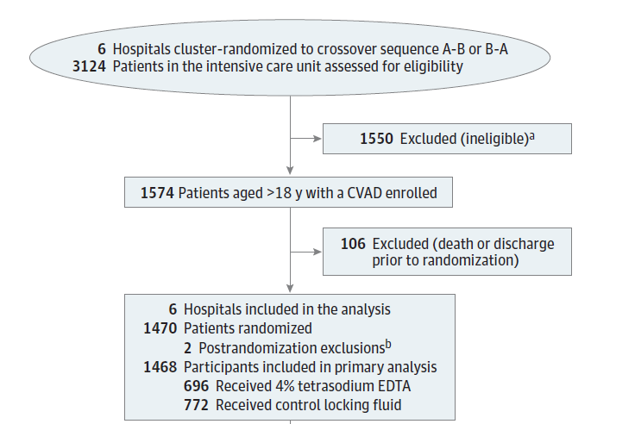
TRIAL FLOW DIAGRAM
Notes:
A Ineligible due to age, absence of CVAD, no CVAD locking events, or decline to receive blood products. Postrandomization exclusions were due to withdrawal of consent (1) and
coenrollment in a competing study
Unit: Randomization occurred at the ICU/hospital level (cluster randomization). Method: Randomization schedule was generated by a statistician and concealed from those involved in intervention delivery.

Slide 39
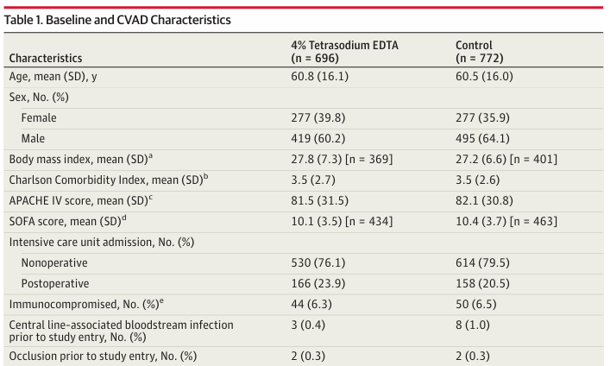

Slide 40
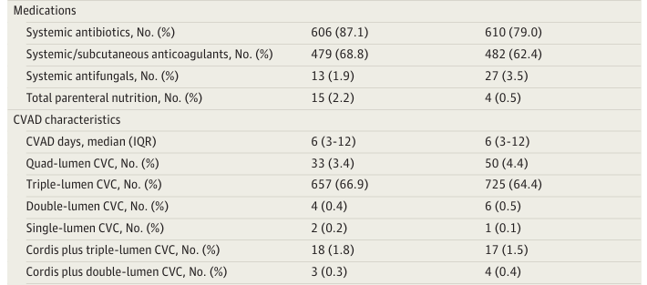
Baseline and CVAD characteristics

Slide 41
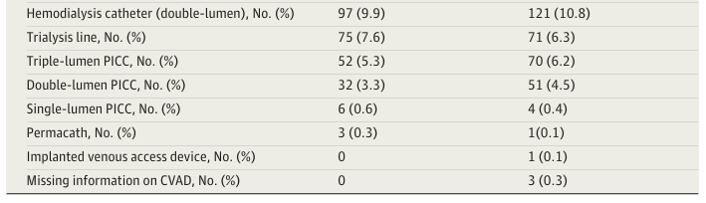
Baseline and CVAD characteristics

Slide 42
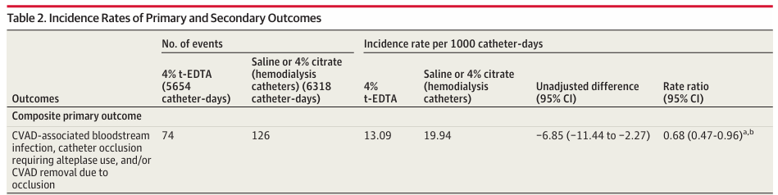
Notes:
Absolute rate difference( unadjusted);The intervention reduced the incidence by 6.85events per 1000catheter days compare to control
Rate ratio; the intervention group had 0.68 times the rate of events compare to control
Meaning; there was 32% relative reduction in incidence rate

Slide 43
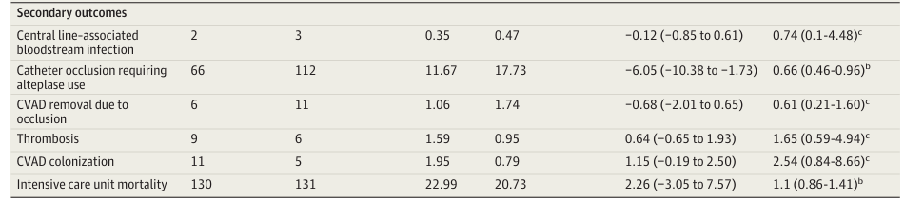
Notes:
ALTEPLASE=34%
CLABSI=26%
OCCLUSION =39%

Slide 44
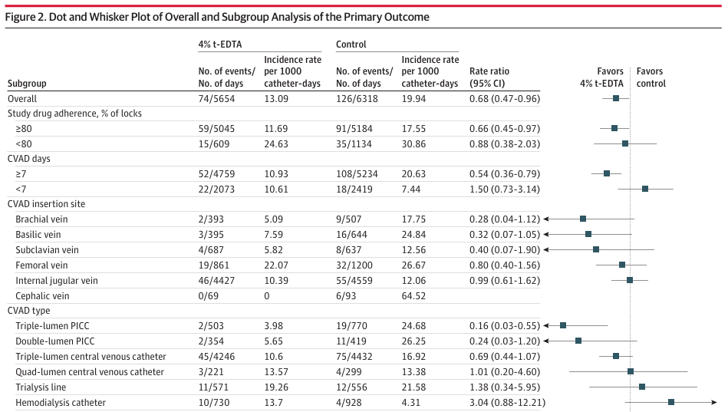

Notes:
ThisFOREST PLOT WHICH displays a sub group analysis of a primary outcomes, with effect measure used being Rate ration (RR) WITH 95% confidence interval
Patients with ≥80% adherence to t-EDTA locks had a 34% lower incidence of the primary outcome compared with control
Patient with an indwelling cather days more than 7 days has 46% lower incidence of the primary outcome compared to the control
Cvad-84%
Hemodialysis catheter suggests that the outcome was about three times more likely in the t-EDTA group than in the control group, meaning the point estimate favors the control in this subgroup
Conclusively; the trial demonstrates a statistically significant benefit for 4% t-EDTA. The subgroup analysis suggests this effect is driven by patient with high treatment adheherence, longer catheter duration(>7days)

Slide 45
PER PROTOCOL ANALYSIS RESULT
Incidence rate of the primary outcome in the per-protocol (PP) group (n=953)
Were 11.52 and 4.0 per 1000 Cather days in the control and t-EDTA groups, respectively, indicating a 65% risk reduction (RR = 0.35 [95% CI: 0.15-0.76]
Notes:
The protective effect of t-EDTA locking was also more pronounced in patients who experienced stronger adherence to study protocol, as exemplified by the ≥80% adherence and PP groups

Slide 46
DISCUSSION
This trial shows that the use of 4% t-EDTA as a CVAD locking fluid in ICU patients led to a reduction in CVAD complications, mainly by decreasing catheter occlusion needing thrombolytic therapy(alteplase)
The impact on infection and thrombosis remains unclear in this population

Slide 47
DISCUSSION
This result is biologically plausible owing to the potent chelation ability of t-EDTA to reduce biofilm and thrombus formation
Also, the observed reduction in alteplase is clinically meaningful as it represents decreased interruption in clinical care
Notes:
HENCE LEADIMG TO DECEREASE ON CLABIS AND CATHTER OCCLUSION
care during which nurses spend more time managing occluded central lines

Slide 48
DISCUSSION
Patient receiving hemodialysis had no improvement in the primary composite outcome with the use of 4% t-EDTA
But the hemodialysis catheters included only 10%, underscoring the need for a future adequately powered study
No adverse events, serious adverse events, or hypocalcemia related to t-EDTA or control locking fluid were reported

Slide 49
DISCUSSION
STRENGTH:
Large pragmatic adult ICU trial addressing a common bedside device-management problem
Triple-blind design with identical masked syringes
Inclusion of multiple CVAD types and both tertiary and community hospitals
The study protocol was integrated into existing ICU procedures, increasing the external validity of the results

Slide 50
DISCUSSION
LIMITATION:
The trial did not reach its planned sample size, although it reached 96% of the target
The study was conducted post-pandemic ICU operational changes, with the sixth ICU added because enrolment was slower than expected
Due to logistical and funding constraints, patients enrolled in this study were followed up only during their ICU hospitalization
Notes:
The planned sample size of 1524 , although 1468 patients

Slide 51
DISCUSSION
LIMITATION:
The study was conducted over two years during pandemic-related changes in critical care, which may have introduced temporal bias
Although this was minimized through a cluster-crossover design, comparable time periods, and a limited 9-month study duration at each site

Slide 52
DISCUSSION
LIMITATION:
The t-EDTA group had higher baseline use of anticoagulants and antibiotics than the control group, which could have confounded the results
However, these imbalances were accounted for in the regression model with covariate adjustment
Notes:
Regression analysis with covariate adjustment is a statistical method used to compare outcomes between groups while controlling for other factors (covariates) that could influence the result

Slide 53
DISCUSSION
Using CLABSI instead of the more specific CRBSI out reduced diagnostic precision but improved comparability with routine surveillance data and previous studies
The small number of CLABSI and CVAD-associated thrombosis events observed limits the interpretability of secondary outcomes
Notes:
and necessitates further evaluation in larger studies

Slide 54
CONCLUSION
Compared with a control locking solution, use of 4% t-EDTA locking solution for CVADs reduced the incidence of a composite outcome of CVAD-associated bloodstream infection, catheter occlusion requiring alteplase use, and catheter removal due to occlusion in adult patients in the ICU

Slide 55
PAPER CRITIQUE
Title/Abstract:
Clear and informative; summarizes background, objectives, and findings well
2. Introduction:
The background provides a clear rationale

Slide 56
PAPER CRITIQUE
3. Methods:
Participants: Clear inclusion and exclusion criteria
Alteplase use, microbiological testing, and line removal decisions were performed at the clinician’s discretion
Follow-up ended at ICU discharge or treatment-period end
Notes:
, so later ward or outpatient CVAD complications were not measured

Slide 57
PAPER CRITIQUE
Randomization:
  Cluster-crossover design is appropriate for a unit-level nursing workflow intervention
  Near-complete randomised cohort retention with only 2 post-randomization exclusions and no missing primary outcome data

Slide 58
PAPER CRITIQUE
4. Outcomes:
  Primary and secondary outcomes were well defined
  No apparent safety signal, including no reported hypocalcemia related to t-EDTA
Statistical Methods:
  Predefined statistical model for event rates and appropriate adjustment for site and treatment period

Slide 59
PAPER CRITIQUE
Results;
  The primary and secondary outcome results are well presented
  The primary composite was driven by alteplase-treated occlusion, not infection or thrombosis
  CLABSI, catheter removal due to occlusion, thrombosis, and colonization events were too rare for precise conclusions
  Protocol adherence was imperfect; only 64.9% of participants were in the per-protocol subgroup
Notes:
Difficulties in operationalizing the protocol to its fullest extent were compounded by issues such as a shortage of nursing staff, post-COVID burnout, and study fatigue
The per-protocol and adherence analyses are biologically coherent but not protected by randomisation

Slide 60
PAPER CRITIQUE
Discussion:
Explained findings in context, mentioning limitations and strengths
Funding:
Some investigators acknowledge receiving personal fees
Notes:
no funder role in design, conduct, analysis, interpretation, or publication decision

Slide 61
WHY THIS PAPER ?
Current high burden of CLABSI with its associated mortality
The need for this trial is particularly high in our resource-limited setting, where the prevalence of CLABSI, CRBSI, and catheter occlusion remains substantial
Antibiotic Lock Therapy in the Era of Antimicrobial Resistance!

Slide 62
TAKE HOME MESSAGE
4 % t-EDTA is a high-affinity metal chelator exhibiting anticoagulant, antimicrobial, and antibiofilm effects, which can be used to prevent occlusion requiring thrombolytic therapy
A call for a poor resource setting -based trial

Slide 63
ACKNOWLEDGMENT
Prof. Patricia Munseri
Dr Baraka Mrisho ( Intensivist)
Dr. Daniel Msilanga (Nephrologist)
Muhimbili ICU doctors
Mr. Peter Kimambi (Biostatistician)
Mr.Abduel Kelakela (Dialysis unit nurse in charge)
Fellow residents

Slide 64
THANK YOU FOR LISTENING

